Slide 1
Ontology: From Socio-culturalism to Post-Humanism
Dr Martina Emke
The Open University, UK

Slide 2
Overview
Take-aways from this presentation
Ontology?!
Background: My thesis
Socio-cultural paradigm
Mixed-methods research design and data collection
(A) Deleuzo-Guattarian research
Working with ontology
Let‘s talk about YOUR worldview(s)

Slide 3
Take-aways from this presentation
Question the ontological assumptions in the studies you use for your research
Question your own worldview – and be prepared to change it
AND
Don‘t be afraid of the „big O“ (Ontology) – Work with it in your research

Slide 4
Ontology?!
1 : a branch of metaphysics concerned with the nature and relations of being Ontology deals with abstract entities.
2 : a particular theory about the nature of being or the kinds of things that have existence
(Source: Merriam-Webster)
What do you see?

Slide 5
Background: My thesis
Increase in number of Part-time language teachers (PTLTs) across educational sectors (Beaton & Gilbert, 2013)
Increase in professional development (PD) demands (Locke, 2014)
Limited access to organised, formal professional development for PTLTs (Stickler & Emke, 2015)
RQ1: How does freelance language teachers’ professional development on…and with…and through Twitter work?
RQ2: What does freelance language teachers’ professional development on…and with…and through Twitter produce?

Slide 6
Beginning: Socio-cultural paradigm
This paradigm regards teacher learning as “emerging out of and through experiences in social contexts” (Johnson, 2006, p. 239).
Transformations in teacher identity and in teaching practice happen through acts of negotiation, interpretation (meaning-making) and mediation (e.g. tools) in social contexts.
Focus on human meaning-making and interpretation relegates non-human elements, such as technology, to a secondary position:
Twitter as a space in which collaborative learning takes place through socio-constructivist processes (Vygotsky, 1978).
View of learning as participation (binaries: active vs. passive; producer (of content) vs. consumer).

Slide 7
Mixed-methods research design
Combining narrative frames (Barkhuizen & Wette, 2008), Social Network Analysis (Wassermann & Faust, 1994) and interviews to gain “a more complete understanding of a research problem than either approach alone” (Creswell, 2014, p. 4).
Data analysis of Twitter hashtag networks to investigate the structural relations between network actors and their positions in a network
Data analysis of qualitative data based on Grounded Theory (Charmaz, 2000)

Slide 8
Data collection…
Data collection: 1 Sep 2016 – 15 Mar 2017
Online narrative frame questionnaire (n=14)
6 research participants (closer investigation)
Tweet capture:
one month individual tweets per participant (n= 2,020)
one month Twitter network tweets per participant (n=13,834)
Twitter networks deemed important for professional development: #ELTchat, #TBLTchat, #LTHEchat
6 semi-structured online interviews
Data analysis

Slide 9
…And then came Deleuze & Guattari…
A Thousand Plateaus (Deleuze & Guattari, 1987): a book as (a) rhizome
Plugging into the Deleuzo-Guattarian concepts
non-binary, non-linear thinking, fluid concepts
no fixed identities → subjectivities are produced through and within assemblages
becoming pertains to humans and non-humans
production of new concept(s) (methodology as research assemblages, Twitter machine)
seeks to produce new thinking and temporal knowledge about social phenomena
experimentations, e.g. Situational Analysis working with Social Network Analysis

Slide 10
Post-structuralism, post-humanism
Where structuralism seeks to establish rules and patterns to understand the core of a (social) phenomenon, post-structuralism traces the effects of the boundaries of a social phenomenon on this phenomenon: “The truth of a population is where it is changing. The truth of a nation is at its borders. The truth of a mind is in its limit cases.” (Williams, 2014, p. 2).
Main proponents: Foucault, Derrida, Lyotard, Deleuze.
Post-humanism is a pluralistic movement which critically questions the function(s) of categories like ‘human’, ‘animal’ or ‘machine’ in the production of human practices and subjectivities (Snaza et al., 2014)
Issues: human dominance (over nature), binary thinking (categories) and interpreting lived experience (representation).

Slide 11
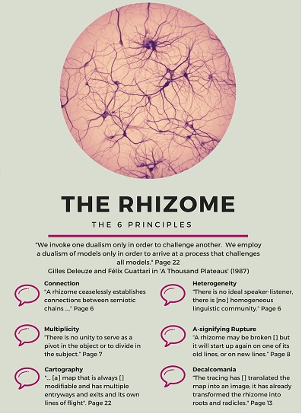
Deleuzo-Guattarian concepts
Rhizome: image of roots, multiplicity
Assemblage: human and non-human comings-together that are capable of producing becoming
Becoming (plural): pertain to human and non-humans; fluid, unpredictable, constantly changing states
Source (picture): Mackness, Bell, Funes (2016), CC-BY

Slide 12
Tweet and hashtag assemblages
Notes:
Explain what you see: the tweet in the centre contains hashtags (openings to new assemblages); the metrics influence how Twitter users are seen and perceived (exprets?); the impressions show how ‘successful’ my tweets were last week (interference of Twitter machine); Twitter recommends who to follow (interference of the Twitter machine); reciprocal relations between user actions, Twitter features and the workings of the Twitter algorithm

Slide 13
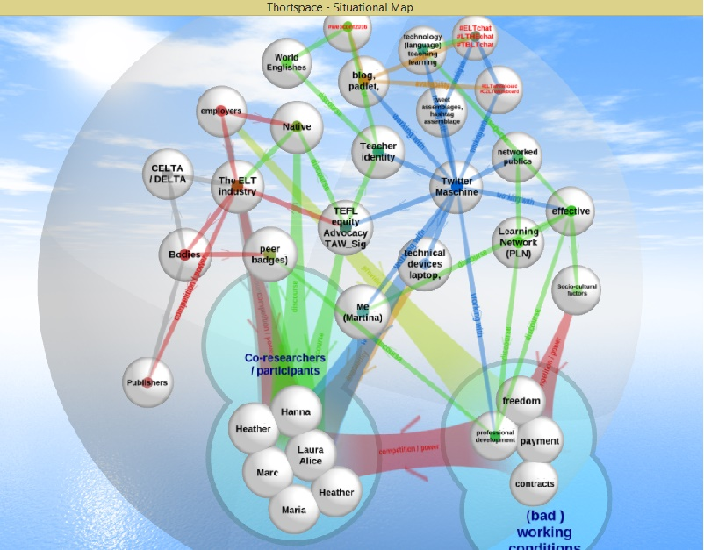
Relational cross-reading of data and Situational Maps (analysis)
Relational cross-reading of data (Emke, 2019):
functions like a map
continuous reading of research data always in relation to data from all other sources and in changing order
helps uncover ‘salient information’ about rhizomatic movements of tweet and hashtag assemblages and about connections with other assemblages on and beyond Twitter
helps gain multiple perspectives of data without falling back into representation
Combined workings of relational cross-reading of data and the creation of Situational Maps (Clarke, 2005)
→ Making socio-constructivist methods work in a post-structuralist, post-human research framework
Example of a Situational Map (Emke, 2019)

Slide 14
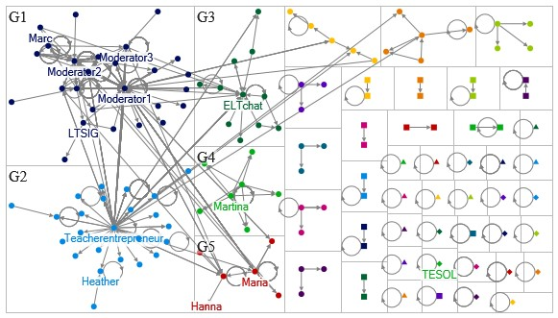
How does freelance language teachers’ Twitter-based PD work?
Language teachers and language teaching co-determine the rhizomatic movement of tweet and hashtag assemblages and are co-constructed through the workings within such assemblages and Twitter’s algorithms.
New, hybrid subjectivities are made available to language teachers, e.g. teacher-entrepreneur.
Source: Emke, 2019

Slide 15
Working with ontology
The research process as “ongoing intermingling of data, methodology and analysis, enmeshed with theorizing the literature and practising the theory” (Sellers, 2015; p. 6).
Engaging with Deleuzo-Guattarian concepts of rhizome, assemblage and becoming in one’s research entails far more than the question of how such concepts could be ‘applied’.
Primarily, engaging means
re-thinking the research framework, and with it re-thinking method(s), and
creating concepts that seek to produce new thinking-doing in your research.

Slide 16
So…let‘s talk about YOUR worldview(s)…
Please go to menti.com and enter the code you will see in the CHAT.
Then answer the question concerning your current worldview.
After that please go to the next question.
Now, let‘s see….

Slide 17
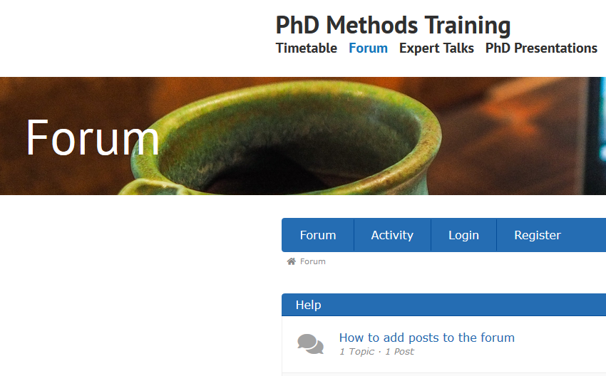
Thank you for your attention!
…. And please post your questions or comments in the Forum.
Martina.Emke@open.ac.uk
@MartinaEmke

Slide 18
Resources 1
Barkhuizen, G., Benson, P., & Chik, A. (2013): Narrative Inquiry in Language Teaching and Learning Research. Florence: Taylor and Francis.
Beaton, F., & Gilbert, A. (Eds.) (2013). Developing effective part-time teachers in higher education: New approaches to professional development. Abingdon: Routledge.
Clarke, A. E. (2005). Situational Analysis. Thousand Oaks, CA: SAGE.
Creswell, J. W. (2014). Research design: Qualitative, quantitative, and mixed methods approaches. Thousand Oaks, CA: SAGE.
Deleuze, G., & Guattari, F. (1987). A Thousand Plateaus: Capitalism and Schizophrenia (B. Massumi, Trans.). Minneapolis, MN: University of Minnesota Press. (Original work published in 1980).
Emke, M. (2019). Freelance Language Teachers' Professional Development On ... And With ... And Through Twitter. EdD thesis. The Open University. http://oro.open.ac.uk/60076/

Slide 19
Resources 2
Johnson, K. E. (2006). The sociocultural turn and its challenges for second language teacher education. Tesol Quarterly, 40(1), 235-257. Retrieved from https://doi.org/10.2307/40264518
Locke, W. (2014). Shifting academic careers: implications for enhancing professionalism in teaching and support learning. Higher Education Academy: York, UK. Retrieved from http://discovery.ucl.ac.uk/10021237/
Sellers, M. (2015). …Working With (a) Rhizoanalysis… and Working (with) a Rhizoanalysis. Complicity, 12(1), 6-31Snaza, N., Appelbaum, P., Bayne, S., Morris, M., Rotas, N., Sandlin, J. & Weaver, J. (2014). Toward a posthumanist education. Journal of Curriculum Theorizing, 30(2), 39-44. Retrieved from http://journal.jctonline.org/index.php/jct/article/viewFile/501/snaza%20etal.pdf
Stickler, U., & Emke, M. (2015). Part-time and freelance language teachers and their ICT training needs. In R. Hampel & U. Stickler (Eds.), Developing online language teaching: research-based pedagogies and reflective practices (pp. 28-44). London: Palgrave Macmillan.

Slide 20
Resources 3
Vygotsky, L. S. (1978). Mind in Society: The development of higher psychological processes. Cambridge, MASS: Harvard University Press.
Wasserman, S. & Faust, K. (1994). Social network analysis: Methods and applications (Vol. 8). Cambridge: Cambridge University Press.
Williams, J. (2014). Understanding Poststructuralism. London: Routledge.
Videos:
On Methodology: Philosophical Underpinnings (Dr Mark Peace)
Three Minute Theory: What is the Rhizome?
Deleuze for the Desperate #1 Introduction (Dave Harris)

